Slide 1
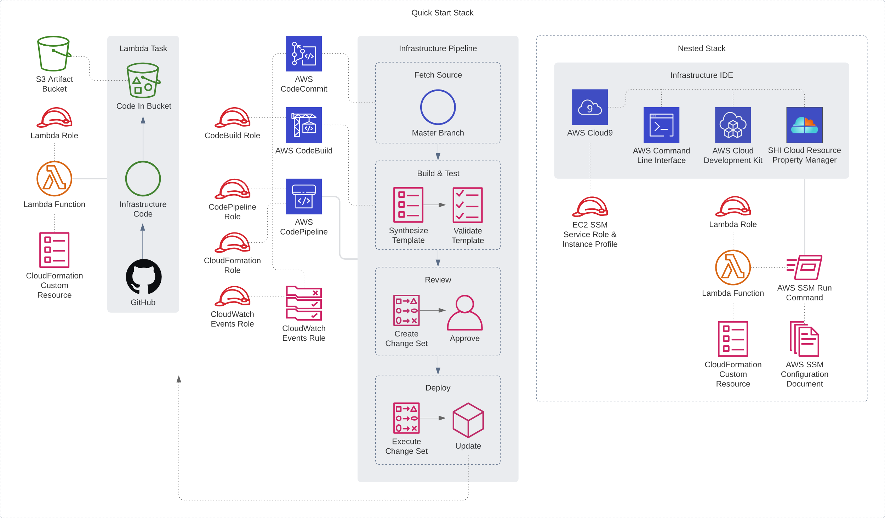

Slide 2

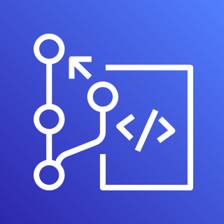


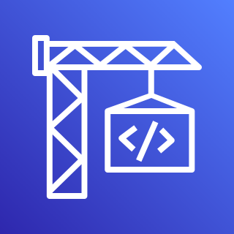




AWS Cloud
Infrastructure Pipeline
AWS CodeCommit
AWS Cloud9
Amazon EventBridge
AWS CodeBuild
Amazon Simple Storage Service (Amazon S3)
AWS Lambda
AWS CodePipeline
IAM Roles

